Slide 1
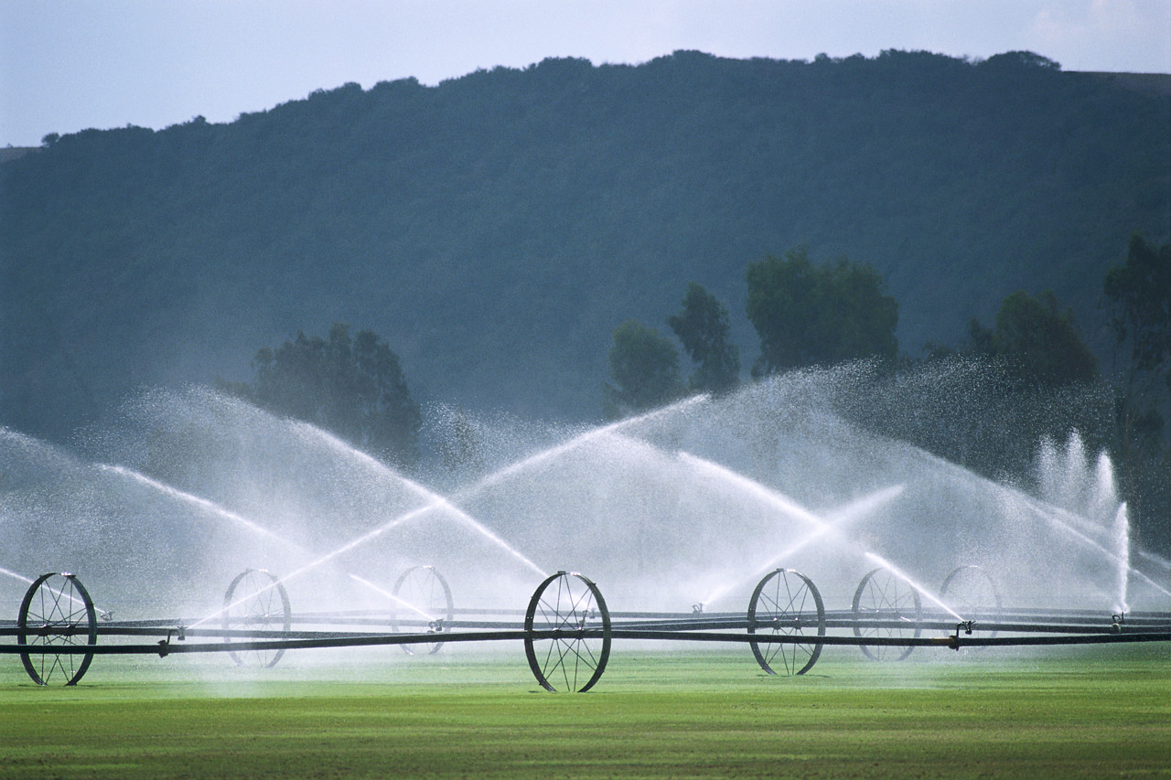
Division of Water Rights
WaterRights.utah.gov

Slide 2
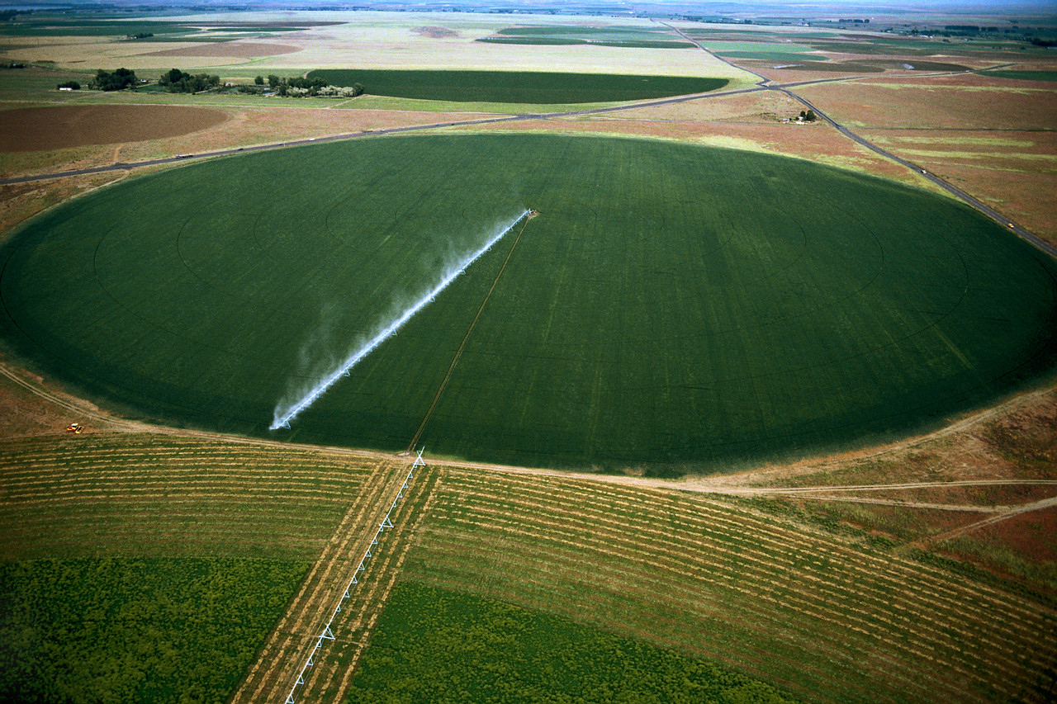
Proof of Beneficial Use of Water
(proof)
Frank Quintana, P.E.
Thursday, April 25th, 2013

Slide 3
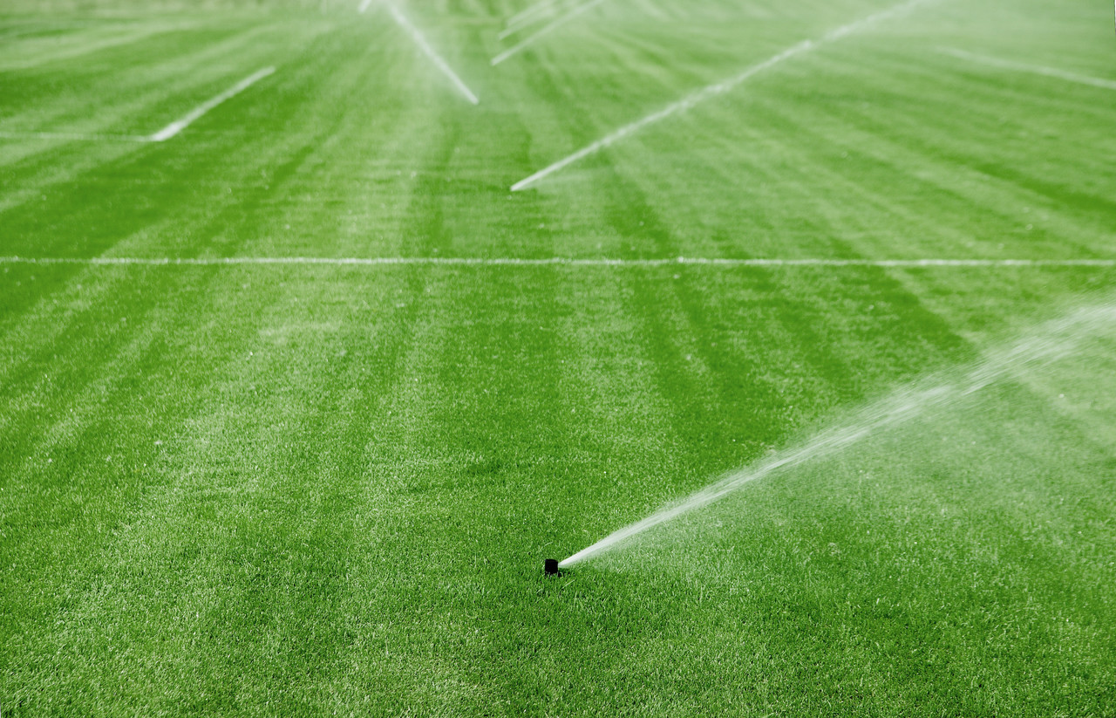
Topics to cover
What is proof?
What options does the applicant
have when proof is due?
What to review before preparing
a proof for a municipality

Slide 4
What is proof of beneficial use of
water?

Slide 5
Example
Water Right Number 22-2222
Application = Proposal
Quantity of Water
Point of Diversion
  Water source (well, spring, river, etc)
  Location
  Diverting works
  Flow
Nature of Use
  Irrigation 5.0 acres
  Domestic 1 family
  Stock watering 20 ELU
Place of Use
  NE¼SE¼ of Section 10,
  T 10N, R 10W, SLB&M
ELU = Equivalent Livestock Units

Slide 6
3 Applications Require Proof
Application to Appropriate Water
Change Application
  Based on existing water right(s)
  Based on shares of stock
Exchange Application
  Based on a valid contract

Slide 7

When the State Engineer approves
an application, he stipulates
a proof-due date

Slide 8
There are two forms to
submit proof

Slide 9
Form No. 1
Proof of Beneficial Use of Water
A professional engineer
or surveyor must prepare it
Applicable to ALL applications

Slide 10
Form No. 2
Affidavit of Beneficial Use of Water
Applicant prepare it
Applicable ONLY to “Small
Amount of Water” applications

Slide 11
Small Amount of Water
Application
Irrigation of ¼ acre
Domestic of 1 family
Stock watering of 10 Equivalent
livestock units

Slide 12
Proof of beneficial use means ACTUAL use; use as it exists when a proof is prepared
It doesn’t mean future use

Slide 13
Example
Water Right Number 22-2222
Application = Proposal
Quantity of Water
Point of Diversion
  Water source (well, spring, river, etc)
  Location
  Diverting works
  Flow
Nature of Use
  Irrigation 5.0 acres
  Domestic 1 family
  Stock watering 20 ELU
Place of Use
  NE¼SE¼ of Section 10,
  T 10N, R 10W, SLB&M
ELU = Equivalent Livestock Units

Slide 14
What options does the applicant
have when proof is due?

Slide 15
Example
Water Right Number 22-2222
Application = Proposal
Quantity of Water
Point of Diversion
  Water source (well, spring, river, etc)
  Location
  Diverting works
  Flow
Nature of Use
  Irrigation 5.0 acres
  Domestic 1 family
  Stock watering 20 ELU
Place of Use
  NE¼SE¼ of Section 10,
  T 10N, R 10W, SLB&M
ELU = Equivalent Livestock Units

Slide 16
Example
Water Right Number 22-2222
Application
Quantity of Water
Point of Diversion
  Well
Nature of Use
  Irrigation 5.0 acres
  Domestic 1 family
  Stock watering 20 ELU
Place of Use
  NE¼SE¼ of Section 10,
  T 10N, R 10W, SLB&M
Actual Use
Quantity of Water
Point of Diversion
  Well
Nature of Use
  Irrigation 3.0 acres
  Domestic 1 family
  Stock watering 10 ELU
Place of Use
  NE¼SE¼ of Section 10,
  T 10N, R 10W, SLB&M
ELU = Equivalent Livestock Units

Slide 17
Possible Options Available
Submit proof
File an extension request
Segregate the undeveloped portion
  File proof on developed portion
  File an extension on segregation

Slide 18
What to review before preparing
a proof for a municipality

Slide 19
Step No. 1
Review Water Use Data
Year | Amount Reported (acre-feet)
2012 | 29 000
2011 | 27 000
2010 | 30 000
2009 | 28 000
2008 | 26 000
Highest amount reported: 30 000 acre-feet

Slide 20
Step No. 2 (Scenario One)
Review perfected and unperfected water rights
Perfected |  | Unperfected
Water Right Number | Quantity of Water | Water Right Number | Quantity of Water
22-2221 | 15 000 | 22-2224 | 20 000
22-2222 | 5 000 | 22-2225 | 10 000
22-2223 | 10 000 | 22-2226 | 15 000
Total | 30 000 | Total | 45 000

Slide 21
Step No. 2 (Scenario Two)
Review perfected and unperfected water rights
Perfected |  | Unperfected
Water Right Number | Quantity of Water | Water Right Number | Quantity of Water
22-2221 | 15 000 | 22-2224 | 20 000
22-2222 | 5 000 | 22-2225 | 10 000
22-2223 | 5 000 | 22-2226 | 15 000
Total | 25 000 | Total | 45 000

Slide 22
If the amount of water reported to
the Water Use Program exceeds
the amount certificated under the
perfected rights, a proof can be submitted
for up to the difference between the
two amounts

Slide 23
Summary
Proofs and affidavits are evidence of ACTUAL uses
Options available when proof is due:
  Submit proof
  Request an extension of time
  File a segregation request to separate any future
  development, then:
    File proof on developed portion
    File extension request on undeveloped portion
Municipal Proof review:
  Review the “Water User Data” submitted to
  “Water Use Program” of the Division of Water Rights
  Review and do an accounting of the perfected and unperfected water rights of the applicant
  If the amount of water reported to the Water Use
  Program exceeds the amount certificated under the
  perfected rights, a proof can be submitted for up to
  the difference between the two amounts

